Slide 1
SERIALIZATION

Slide 2

Agenda
What is Serialization?
Binary serialization
XML Serialization in C#
Serialization in JSON format

Slide 3
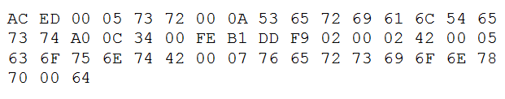
What is Serialization?
Serialization is the process of transforming an object or object graph that you have in-memory into a stream of bytes or text.
Deserialization is the opposite. You take some bytes or text and transform them into an object.
[Serializable]
public class Person
{
…
}
Person st1 = new Person();
st1.FirstName = “Iryna";
st1.LastName = “Koval";
st1.BirthDate = new DateTime(1981, 8, 17);
Deserialization
Serialization

Slide 4
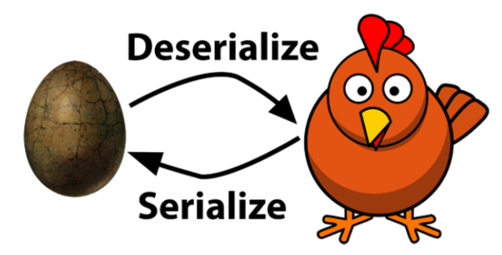
Serialization in .NET
.NET Framework has supports:
binary,
XML,
JSON,
own custom serialization.
The .NET Framework offers classes for serialization mechanisms that you can use by default:
BinaryFormatter
XmlSerializer
JsonSerializer

Slide 5

Binary serialization
In binary serialization all items are serialized, even private field and read-only
In binary serialization, there is used a binary encoding to provide a compact object serialization for storage or transmission
namespace System.Runtime.Serialization.Formatters.Binary
Class BinaryFormatter.

Slide 6
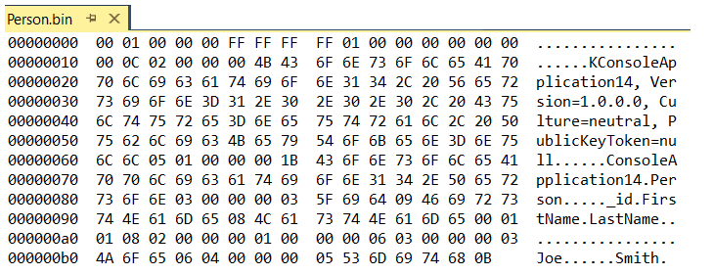
BinaryFormatter
[Serializable]
class Person
{
private int _id;
public string FirstName;
public string LastName;
public void SetId(int id)
{
_id = id;
}
}
Person person = new Person();
person.SetId(1);
person.FirstName = "Joe";
person.LastName = "Smith";
IFormatter formatter = new BinaryFormatter();
Stream stream = new FileStream("Person.bin",
FileMode.Create, FileAccess.Write, FileShare.None);
formatter.Serialize(stream, person);
stream.Close();
stream = new FileStream("Person.bin",
FileMode.Open, FileAccess.Read, FileShare.Read);
Person person2 = (Person)formatter.Deserialize(stream);
stream.Close();

Slide 7
BinaryFormatter: Attributes
To indicate that instances of this type can be serialized, mark it with the [Serializable] attribute. When you try to serialize the type that has no such attribute, a SerializationException occurs.
If you do not want to serialize the fields within a class, apply the [NonSerialized] attribute.
If a serializable class contains references to objects of other classes that are marked with a [Serializable] attribute, those objects are also serializable.
the [OptionalField] attribute is used to make sure that the binary serializer knows that a field is added in a later version and that earlier serialized objects won’t contain this field

Slide 8

XMLSerializer
XML is readable by both humans and machines, and it is independent of the environment it is used in.
To serialize an object:
Create the object and set its public fields and properties.
Construct a XmlSerializer using the type of the object.
Call the Serialize method to generate either an XML stream or a file representation of the object's public properties and fields
To deserialize an object:
Construct a XmlSerializer using the type of the object to deserialize.
Call the Deserialize method to produce a replica of the object. After deserialization you must cast the returned object to the type of the original

Slide 9
XMLSerializer
Person st1 = new Person();
st1.FirstName = "John";
st1.LastName = "Doe";
XmlSerializer xmlser = new XmlSerializer(typeof(Person));
Stream serialStream = new FileStream("person.xml", FileMode.Create);
xmlser.Serialize(serialStream, st1);
<? xml version = "1.0" ?>
< Person xmlns:xsi = "http://www.w3.org/2001/XMLSchema-instance" xmlns: xsd = "http://www.w3.org/2001/XMLSchema" >
< FirstName > John </ FirstName >
< LastName > Doe </ LastName >
</ Person >
serialStream = new FileStream("person.xml", FileMode.Open);
Person st2 = xmlser.Deserialize(serialStream) as Person;
Console.WriteLine(st2);

Slide 10
XMLSerializer: Attribute
You can configure how the XmlSerializer serializes your type by using attributes. These attributes are defined in the System.Xml.Serialization namespace :
XmlIgnore - can be used to make sure that an element is not serialized
XmlAttribute - you can map a member to an attribute on its parent node.
XmlElement – by default
XmlArray - is used when serializing collections.
XmlArrayItem - is used when serializing collections.

Slide 11
Complex and derived types serialization
[Serializable]
public class Person
{
public string FirstName { get; set; }
public string LastName { get; set; }
public int Age { get; set; }
}
[Serializable]
public class VIPOrder : Order
{
public string Description { get; set; }
}
[Serializable]
public class OrderLine
{
[XmlAttribute]
public int ID { get; set; }
[XmlAttribute]
public int Amount { get; set; }
[XmlElement(“OrderedProduct”)]
public Product Product { get; set; }
}
[Serializable]
public class Order
{
[XmlAttribute]
public int ID { get; set; }
[XmlIgnore]
public bool IsDirty { get; set; }
[XmlArray(“Lines”)]
[XmlArrayItem(“OrderLine”)]
public List<OrderLine> OrderLines { get; set; }
}
[Serializable]
public class Product
{
[XmlAttribute]
public int ID { get; set; }
public decimal Price { get; set; }
public string Description { get; set; }
}

Slide 12
Complex and derived types serialization
private static Order CreateOrder()
{
Product p1 = new Product { ID = 1, Description = “p2”, Price = 9 };
Product p2 = new Product { ID = 2, Description = “p3”, Price = 6 };
Order order = new VIPOrder { ID = 4, Description = “Order for John Doe. Use the nice giftwrap”,
OrderLines = new List<OrderLine> {
new OrderLine { ID = 5, Amount = 1, Product = p1},
new OrderLine { ID = 6 ,Amount = 10, Product = p2},
}};
return order;
}
XmlSerializer serializer = new XmlSerializer(typeof(Order), new Type[] { typeof(VIPOrder) });
string xml;
using (StringWriter stringWriter = new StringWriter())
{
Order order = CreateOrder();
serializer.Serialize(stringWriter, order);
xml = stringWriter.ToString();
}
using (StringReader stringReader = new StringReader(xml))
{ Order o = (Order)serializer.Deserialize(stringReader);
// Use the order
}

Slide 13
JSON Serialization
We can use JsonSerializer to serialize type instance to JSON string and deserialize JSON string to type instance
Standard JsonSerializer is under System.Text.Json namespace.
https://metanit.com/sharp/tutorial/6.5.php
As alternative, you can use JsonSerializer class from Newtonsoft
This JsonSerializer is under Newtonsoft.Json namespace
https://www.newtonsoft.com/json/help/html/T_Newtonsoft_Json_JsonSerializer.htm

Slide 14
JSON Serialization
Using System.Text.Json;
class Person
{
public string Name { get; set; }
public int Age { get; set; }
}
class Program
{
static void Main(string[] args)
{
Person tom = new Person { Name = "Tom", Age = 35 };
string json = JsonSerializer.Serialize<Person>(tom);
Console.WriteLine(json);
Person restoredPerson = JsonSerializer.Deserialize<Person>(json);
Console.WriteLine(restoredPerson.Name);
}
}
Serialized object must have constructor without parameters.
Only public properties a serialized
{"Name":"Tom","Age": 35}
Tom

Slide 15
Thank you!

